Slide 1
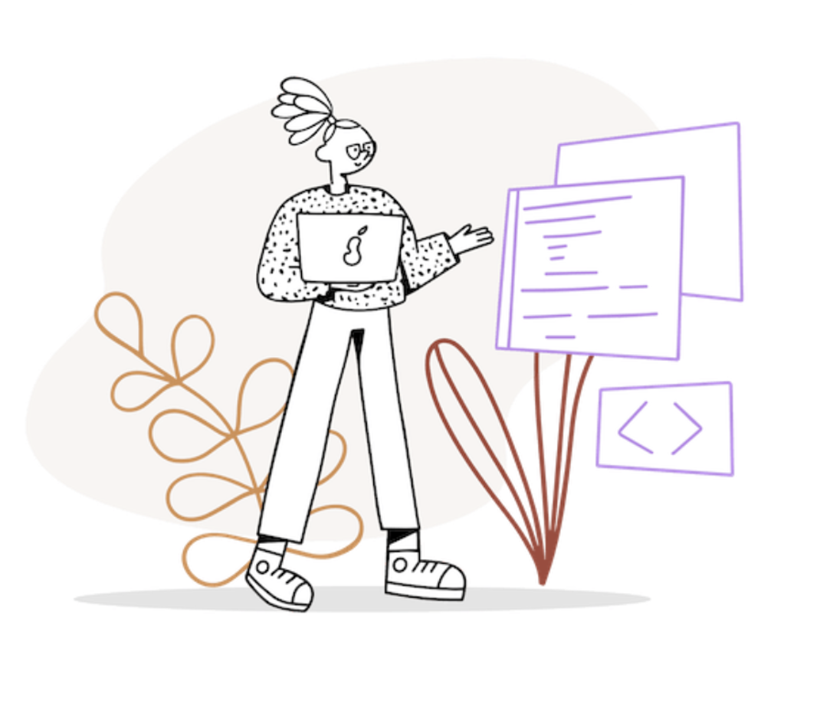
Programming Final Exam Project
Arthur Okseniuk
Ravshanbek Musaaev
Mark Shafarenko
Sadovska Kateryna
Nazar Zhanabergenov
Rahimov Sagdii
Shamilyeva Dinara
World Cup FootballTournamentSystem

Slide 2
What materials we used
Flags for each country
Fifa Info
Languages:
Python
Design:
JavaScript
Css
Html
External libraries:
Eel
Glob

Slide 3
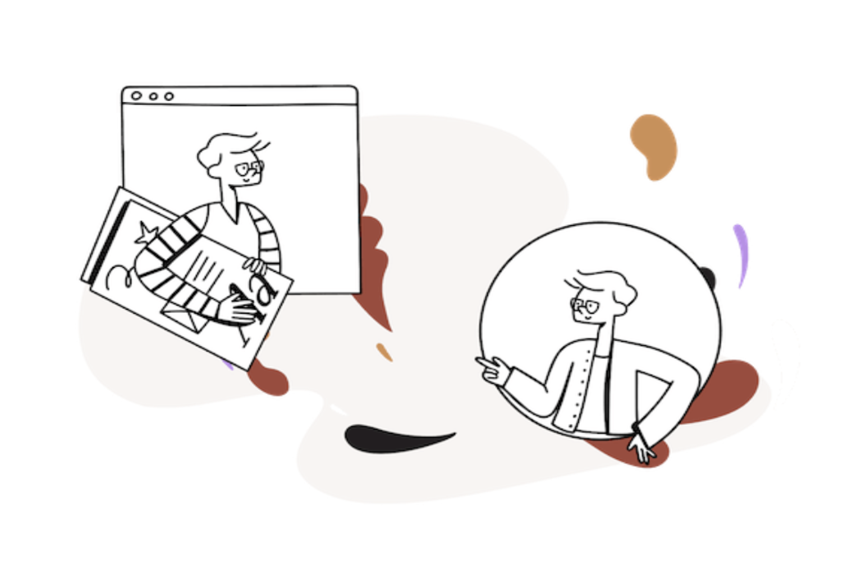


We used the following programs:
Discord (Here we had team meeting and discussed the project, divided tasks )
PyCharm (The development environment where we wrote the code )

Slide 4


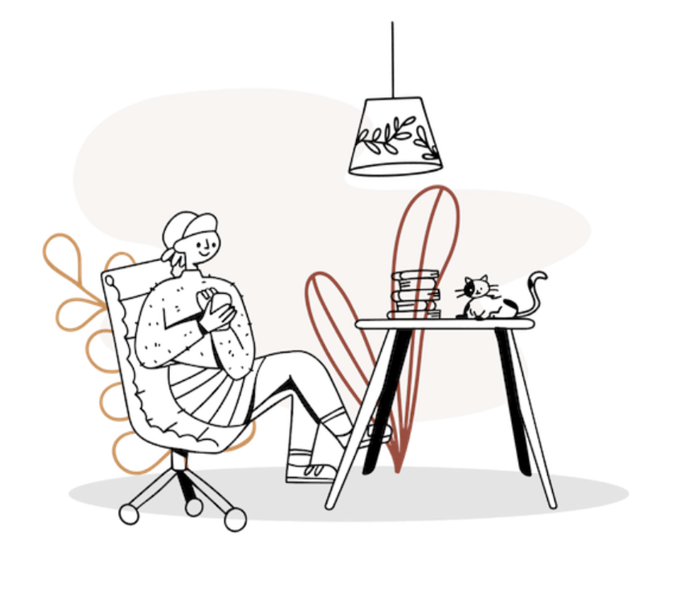
Github (program for the control version of the code )
Sublime Text (a text editor)

Slide 5
Distributing
Programming
Zhanabergenov Nazar,Ravshanbek Musaev, Okseniuk Artur, Sadovska Kateryna
Design
Rahimov Sagdii, Okseniuk Artur
Presentation
Documentation
Shamilyeva Dinara, Mark Shafarenko
Each of us was involved in every process, and there are people who were responsible for overseeing their part.

Slide 6
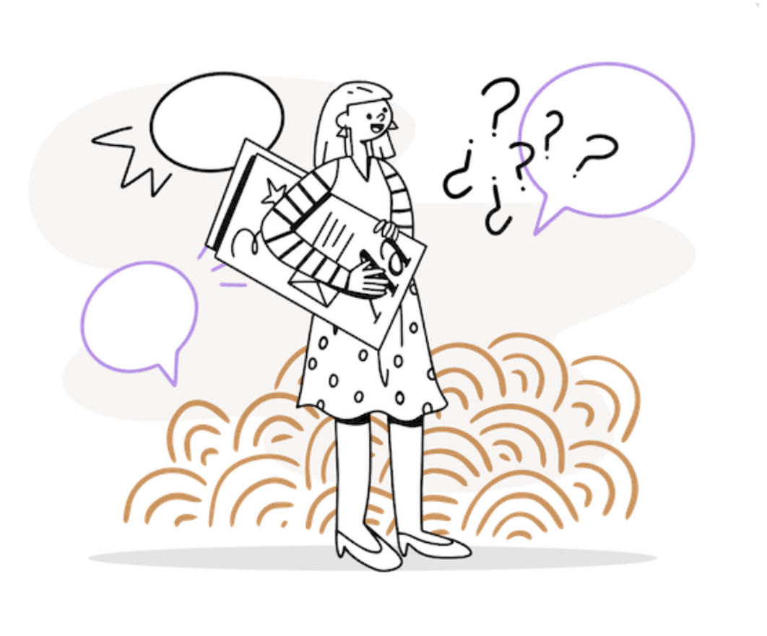
Task: 1: Creating Competition System
Our job is to create a system that used to organize the football matches of the world cup starting from group’s tournament to the final match, and organize the groups according to the match’s games
The user can add 32 teams, and then distribute them into 8 groups,the first and second winners in the each group will play in round of 16, and then the winners will play in quarterfinals, and so one.

Slide 7
We wrote our program using the principles of the OOP
First we created six classes:
Team ( This class was created to contain general information about the football team ).
Group (Here we have divided the teams into groups of four teams each. )
Round16 (Two teams with the best results from each group are automatically added to this class )

Slide 8
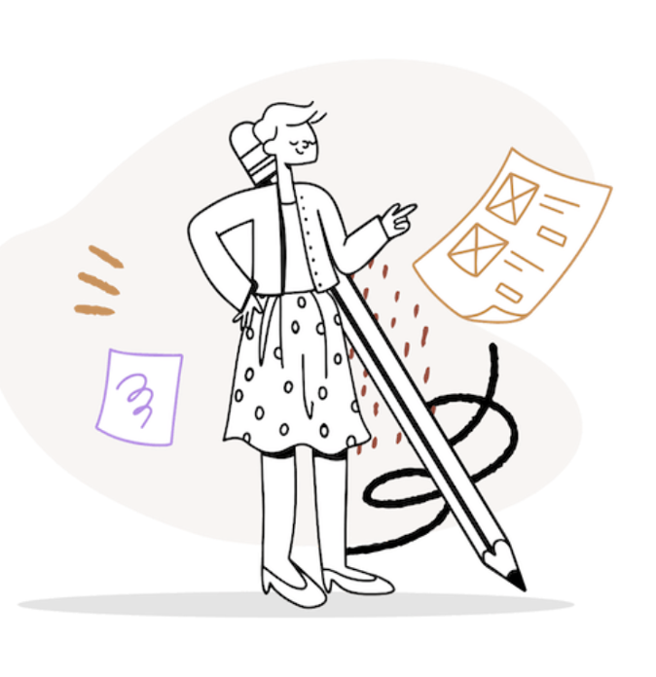
QFinal (In this class we put the remaining two commands that were the best in round16. Here the teams play with their "neighbors”. )
SFinal (Here we have the semifinals, the program itself throws in the top four teams from the last object. )
Final (In this class the program adds
the 2 strongest teams. )

Slide 9
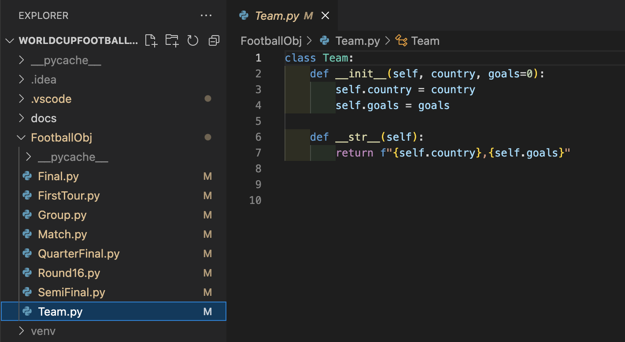

Slide 10
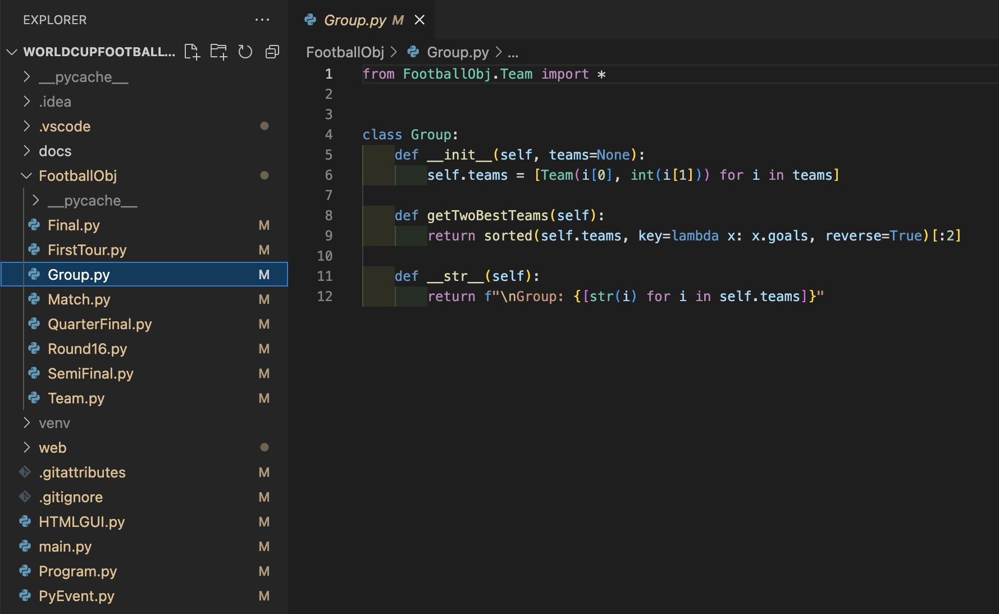

Slide 11
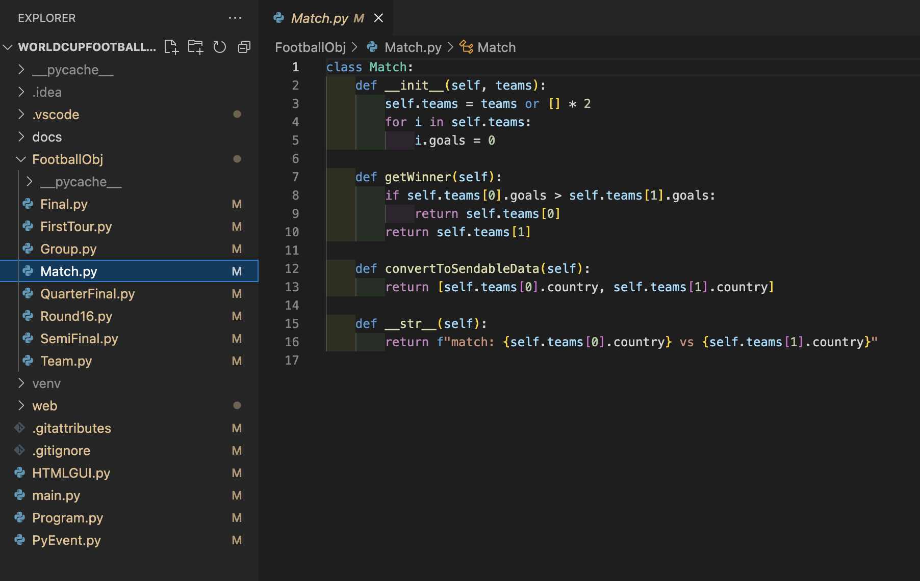

Slide 12
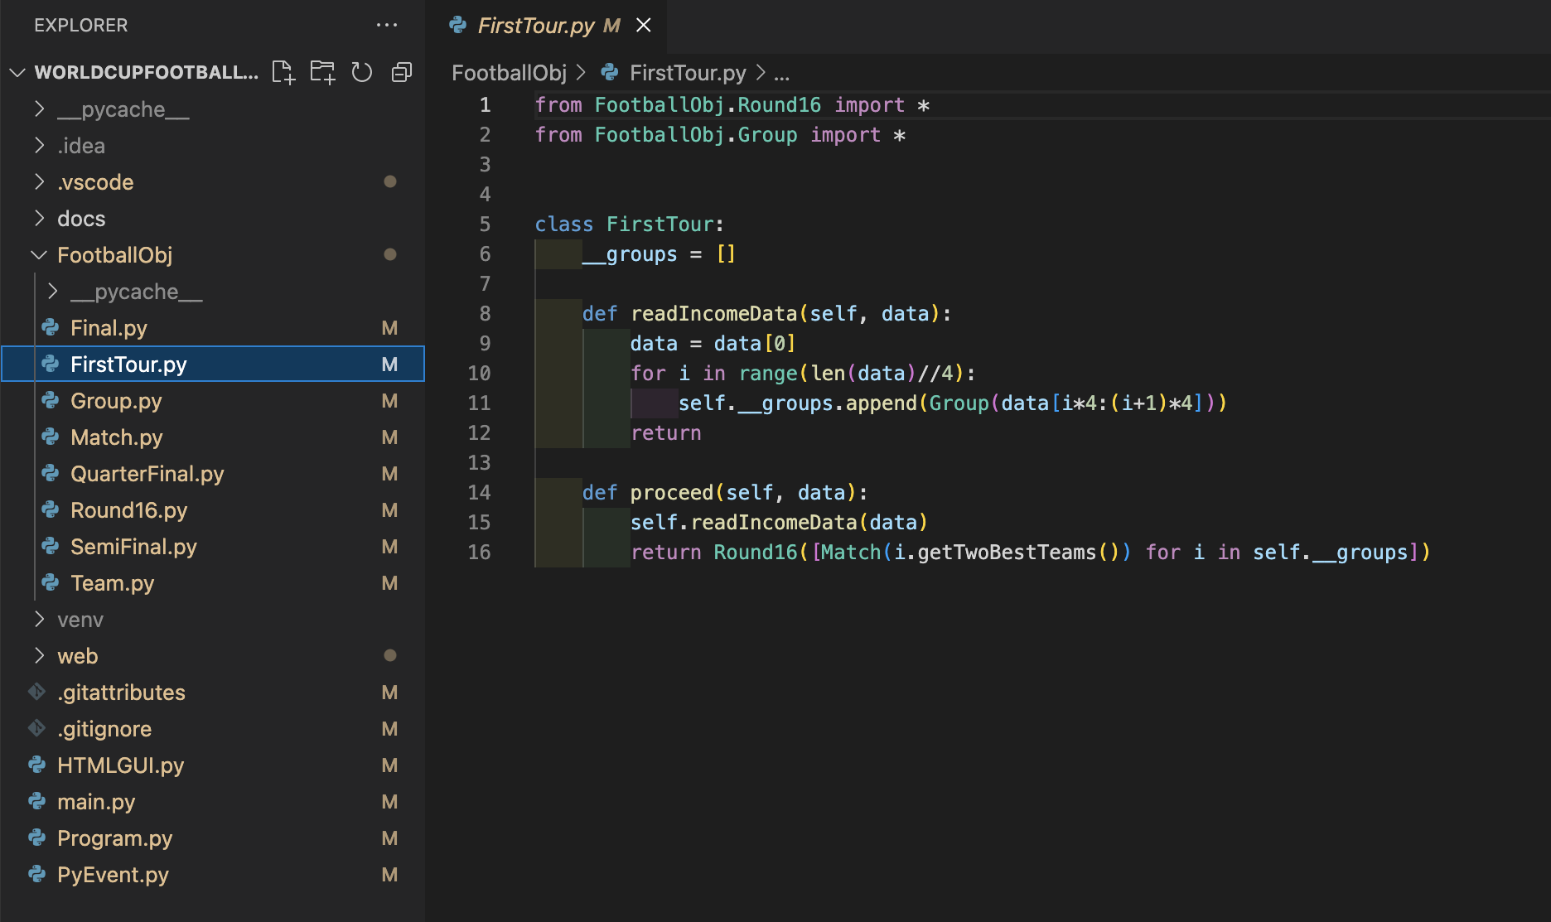

Slide 13
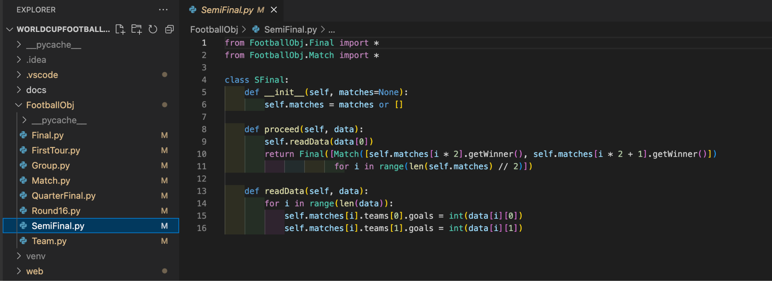

Slide 14
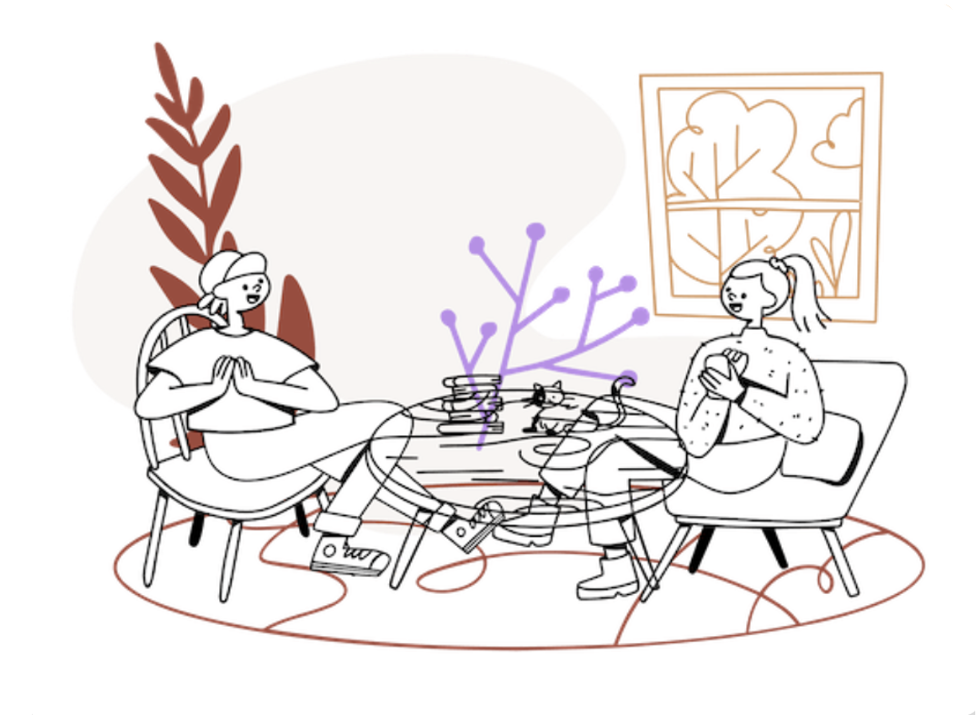
When starting the program, the user can create 8 groups of 4 teams. The information itself he can choose from a list that is given to him. Also enter the data on the goals scored and based on these results the teams will move up the hierarchy of the tournament.

Slide 15
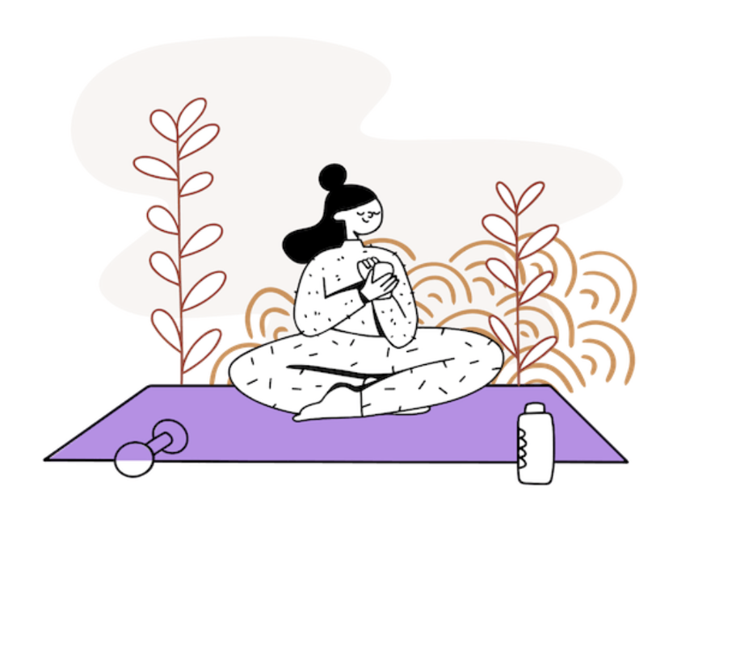
In order for the program to work completely correctly, the user must only enter the results, which must coincide with the final results of the tournament itself.
After that, the system itself will give the results and the winners of the world championship
The system will write all team results at each stage of the competition

Slide 16
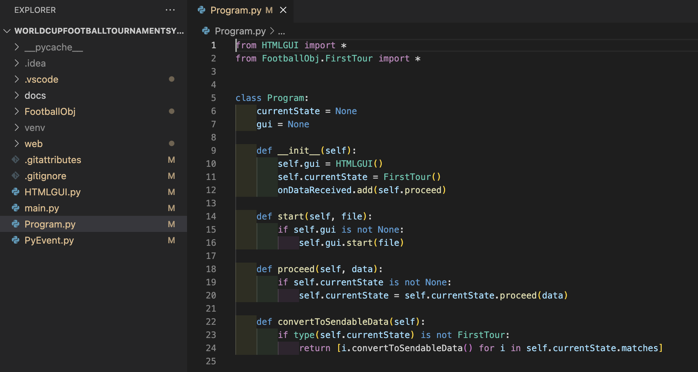

Slide 17
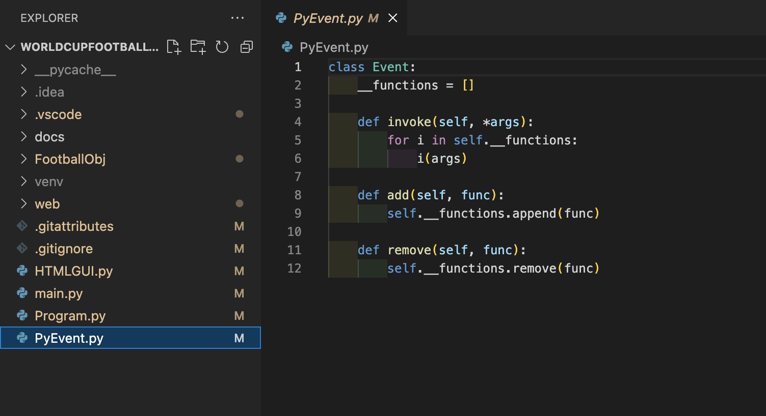

Slide 18
Task 2: Testing the system
We used the integrated google utilities to check the status and view the used memory.
And also thanks to Dev. Tools we found that some parts were had a low performance so we have optimized some of them and get rid of others.

Slide 19
Task 3: GUI system
The first step in our design of the site itself was a prototype that we created in Figma.
All colors and fonts are from the official 2022 World Cup in Qatar. We tried to make our design as similar to the original tournament grid as possible.
Next point was programming User interface using javascript with html, css

Slide 20
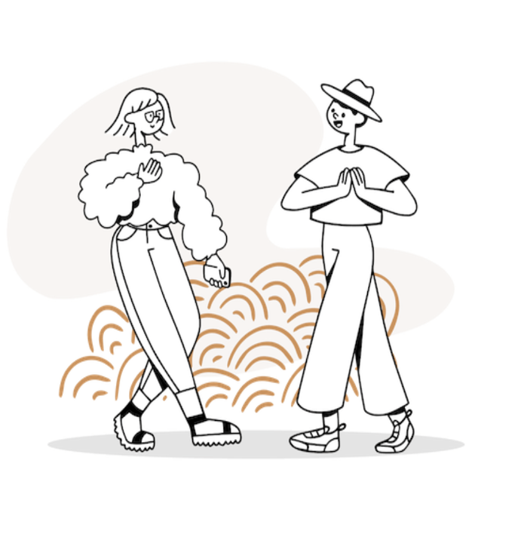
After we created the frontend, we linked it to the backend. We used a special library to create standalone applications with full access to Python's features and libraries. Eel (the library) hosts the local web server, then allows you to annotate functions in Python so they can be called from Javascript.

Slide 21
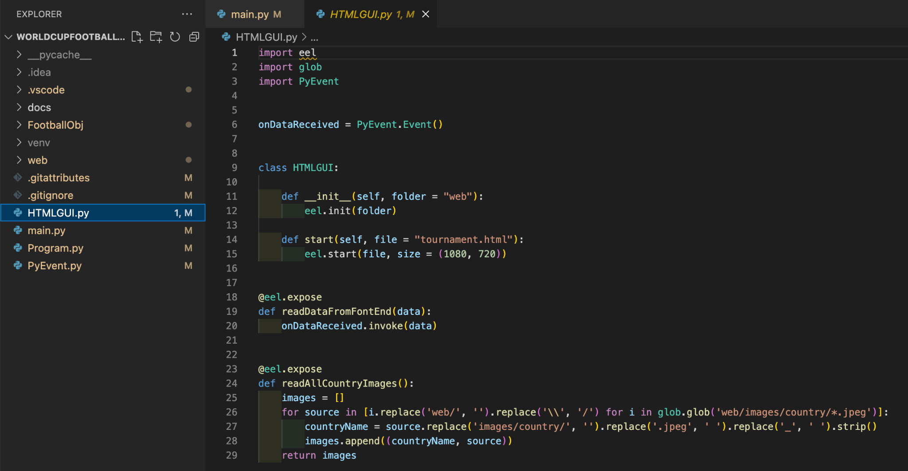

Slide 22
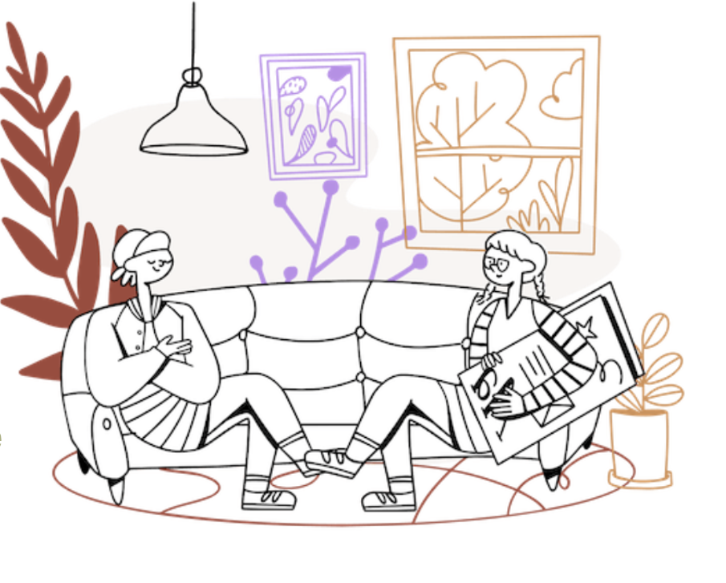
Then we all, as a team, sat down to write the documentation. (We tried to comment on the code itself, but it just turned into unreadable mush.)
This is the same as commenting, but much more convenient for larger projects.
After all this work, we have already begun to create the presentation. We found a visual, decided on fonts and colors, and made the presentation in one evening.

Slide 23

Just before we handed it over, we also designed everything, so that if something happens, we can quickly solve all the problems. All super!
Thank you

